Slide 1
Advancements in spatio-temporal models in TMB
May 31, 2016

Slide 2
Outline
Review
Laplace approximation and separable computation
Four big-N problems
Spatial correlation matrices
Covariance matrices
Movement matrices
Interaction matrices
Uber-model

Slide 3
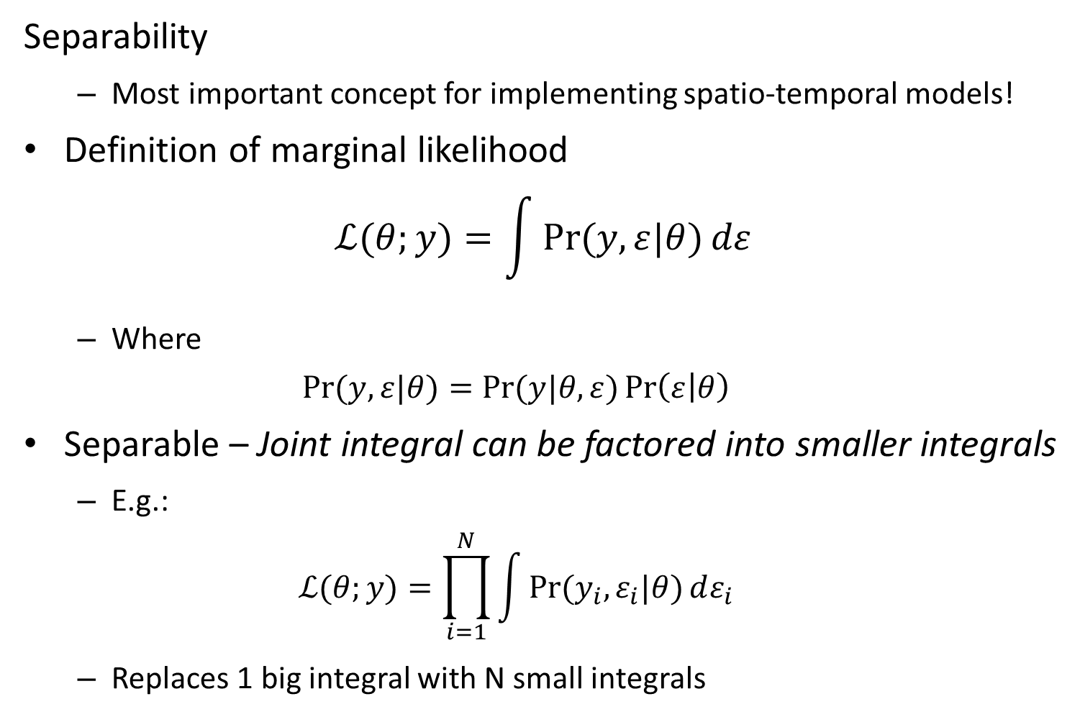
Review: Separable computation
Separability
Most important concept for implementing spatio-temporal models!
Definition of marginal likelihood
$$ℒ(θ;y)=\int{\operatorname{Pr}{(y,ε|θ)}dε}$$
Where
$$\operatorname{Pr}{(y,ε|θ)}=\operatorname{Pr}{(y|θ,ε)}\operatorname{Pr}\left(ε | θ\right)$$
Separable – Joint integral can be factored into smaller integrals
E.g.:
$$ℒ(θ;y)=\prod_{i=1}^{N}{\int{\operatorname{Pr}{(y_{i},ε_{i}|θ)}dε_{i}}}$$
Replaces 1 big integral with N small integrals

Slide 4
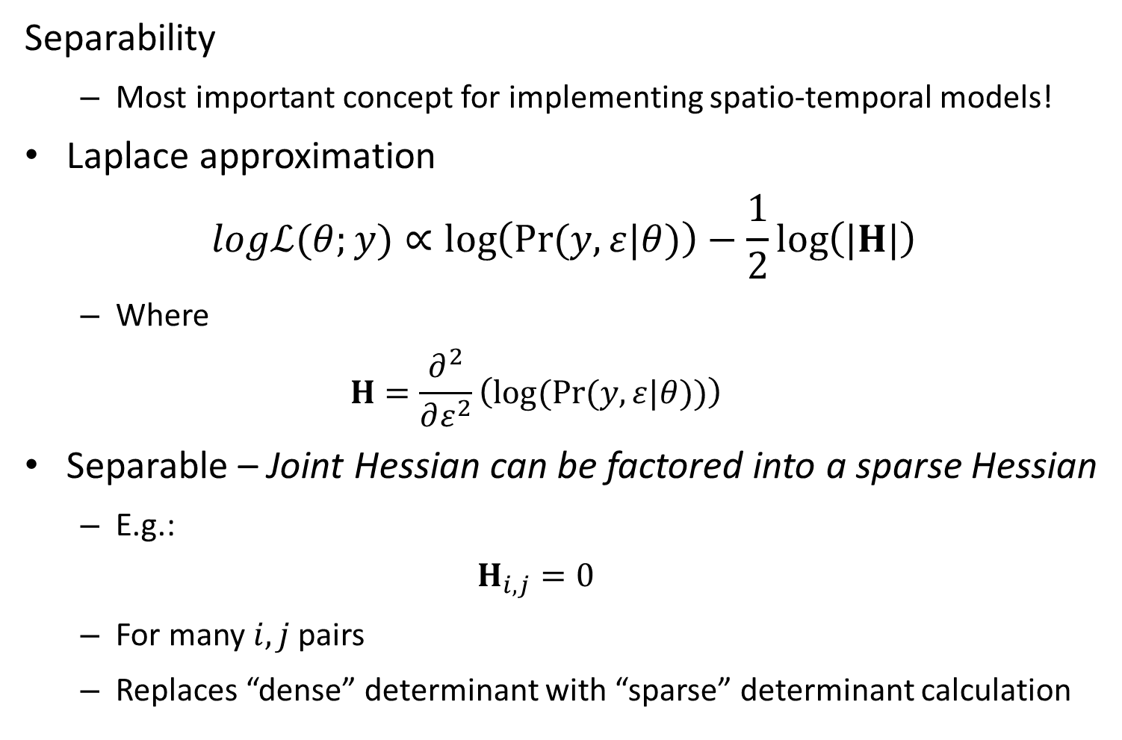
Review: Separable computation
Separability
Most important concept for implementing spatio-temporal models!
Laplace approximation
$$logℒ(θ;y)∝\log\left(\operatorname{Pr}{(y,ε|θ)}\right)−\frac{1}{2}\log\left(|H|\right)$$
Where
$$H=\frac{∂^{2}}{∂ε^{2}}\left(log⁡(\operatorname{Pr}{(y,ε|θ)})\right)$$
Separable – Joint Hessian can be factored into a sparse Hessian
E.g.:
$$H_{i,j}=0$$
For many $i,j$pairs
Replaces “dense” determinant with “sparse” determinant calculation

Slide 5
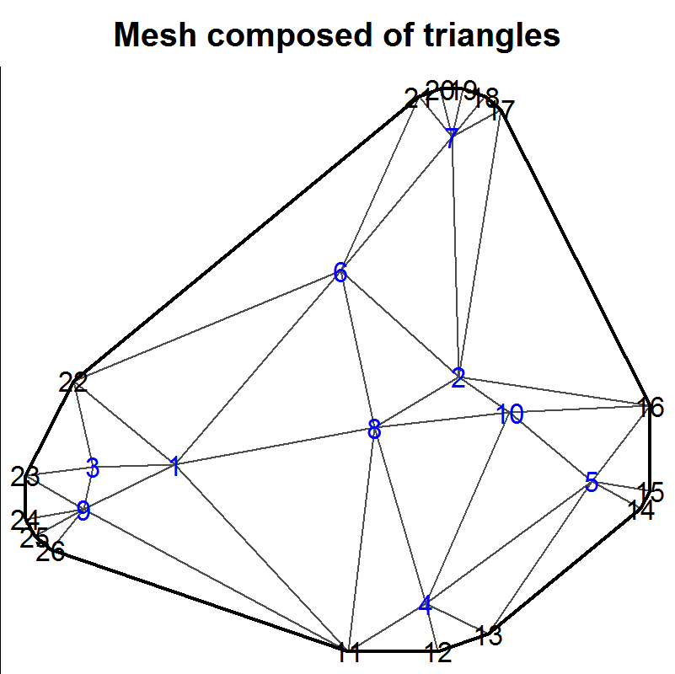
Spatial Correlation
Four sparse methods
2D autoregressive process
Kroenecker product of each dimension
Local Conditional Autoregressive (LCAR)
Areal model with irregular shapes
SPDE approximation
Point-process model
Geometric or nonstationary anisotropy
Network correlations
Ornstein-Uhlenbeck process on an acyclic graph
Stream or phylogenetic networks

Slide 6
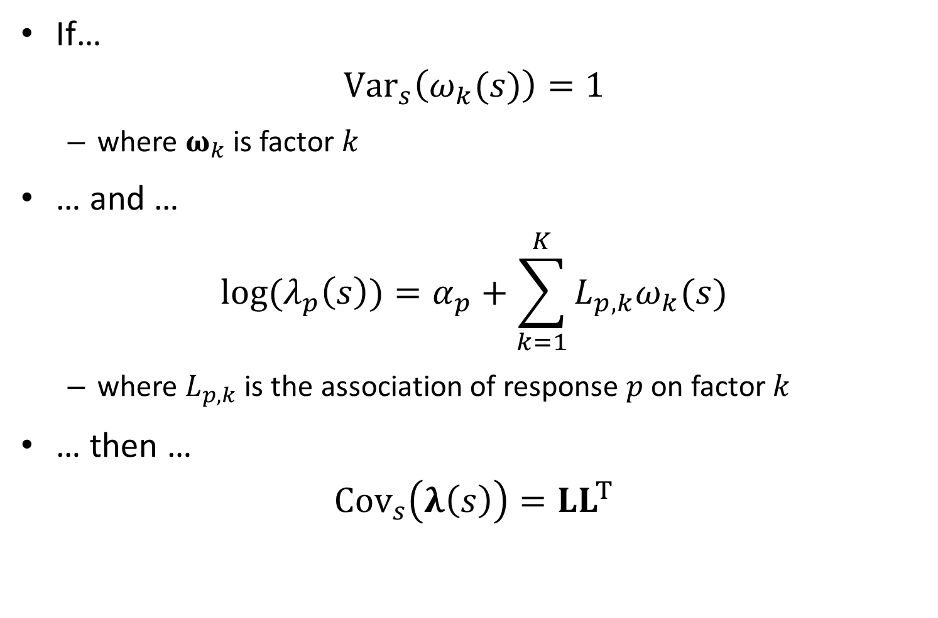
Factor decomposition
If…
$${Var}_{s}\left(ω_{k}(s)\right)=1$$
where $ω_{k}$ is factor $k$
… and …
$$log⁡(λ_{p}\left(s\right))=α_{p}+\sum_{k=1}^{K}{L_{p,k}ω_{k}(s)}$$
where $L_{p,k}$ is the association of response $p$ on factor $k$
… then …
$${Cov}_{s}\left(λ\left(s\right)\right)=LL^{T}$$

Slide 7
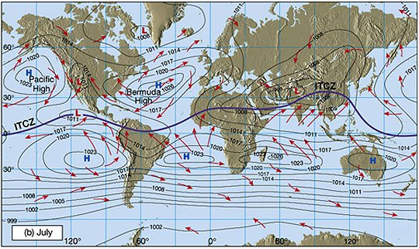
Movement math
Remote Sensing Tutorial (http://fas.org/irp/imint/docs/rst/)
Thorson, J.T., Jannot, J.E., and Somers, K. In press. Using spatio-temporal models of population growth and movement to monitor overlap between human impacts and population density. J. Appl. Ecol.

Slide 8
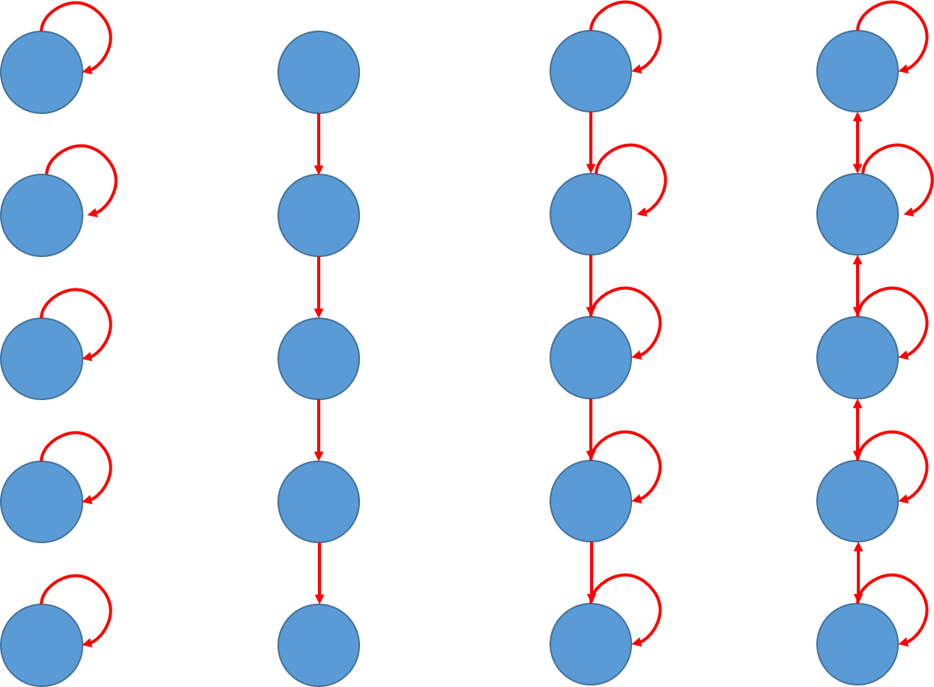
Movement
Different forms of movement
No movement
Rail car
Partial migration
Diffusion

Slide 9
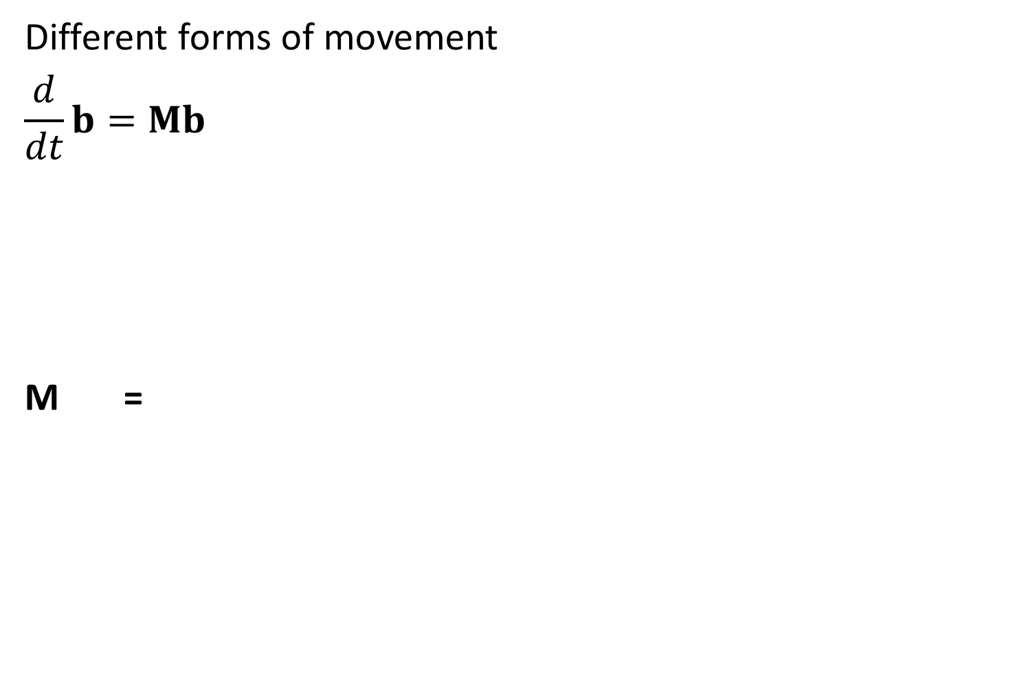
Different forms of movement
$$\frac{d}{dt}b=Mb$$
M =
No movement
1
 | 1
 |  | 1
 |  |  | 1
 |  |  |  | 1

Slide 10
Different forms of movement
$$\frac{d}{dt}b=Mb$$
M =
Diffusion
1-p | p
p | 1-2p | p
 | p | 1-2p | p
 |  | p | 1-2p | p
 |  |  | p | 1-p

Slide 11
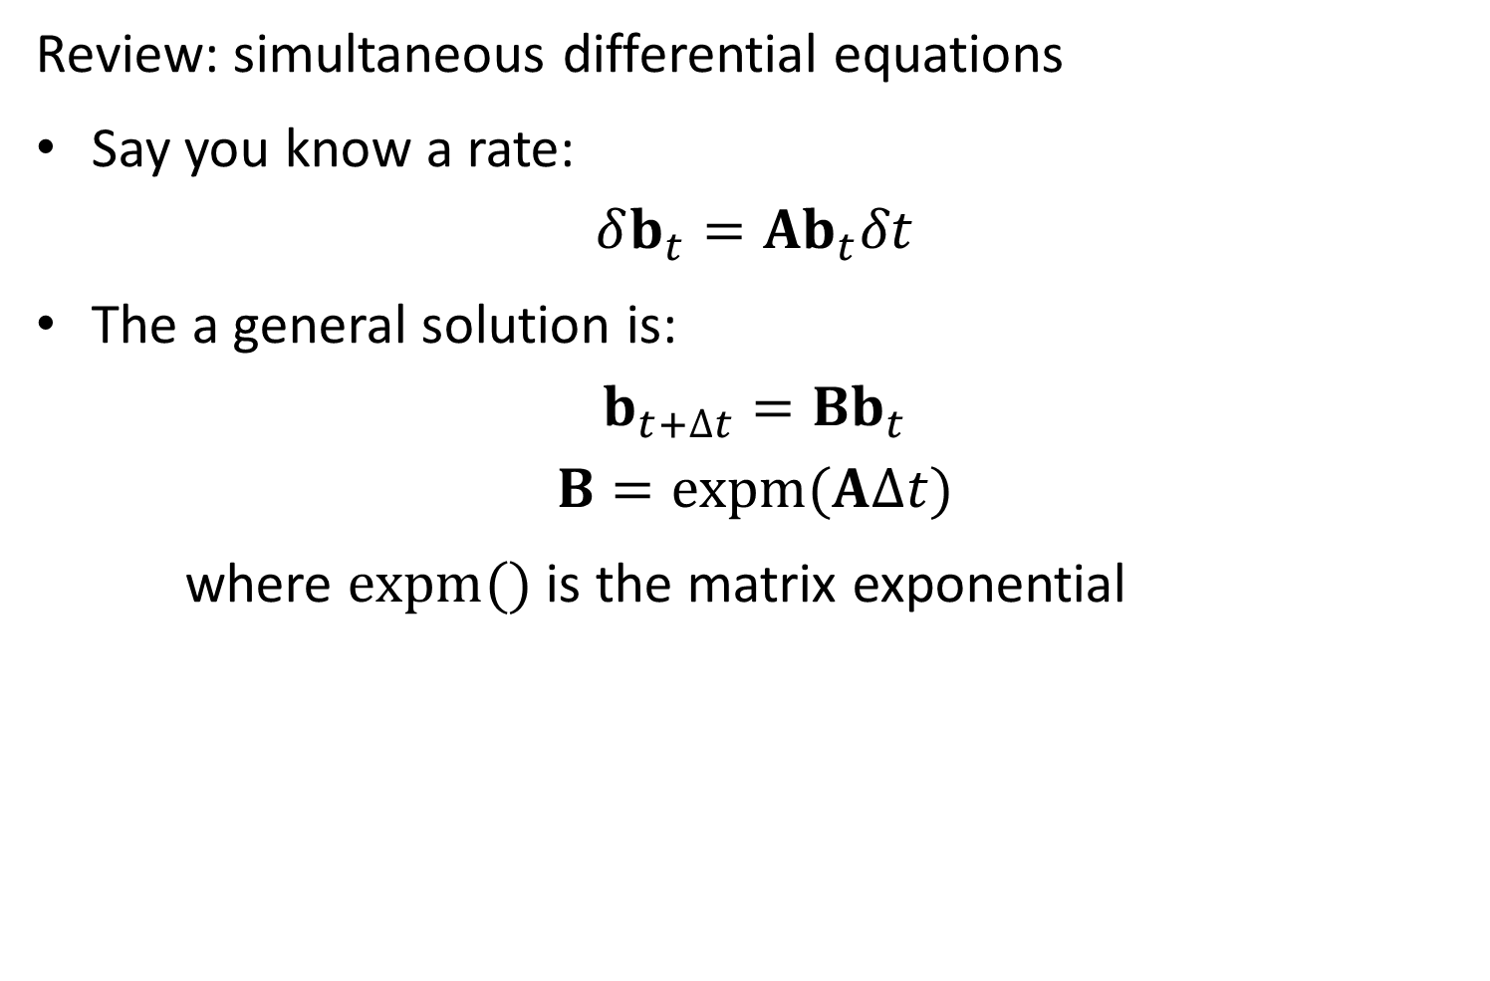
Movement
Review: simultaneous differential equations
Say you know a rate:
$$δb_{t}=Ab_{t}δt$$
The a general solution is:
$$b_{t+∆t}=Bb_{t}$$
$$B=expm(A∆t)$$
where $expm()$ is the matrix exponential

Slide 12
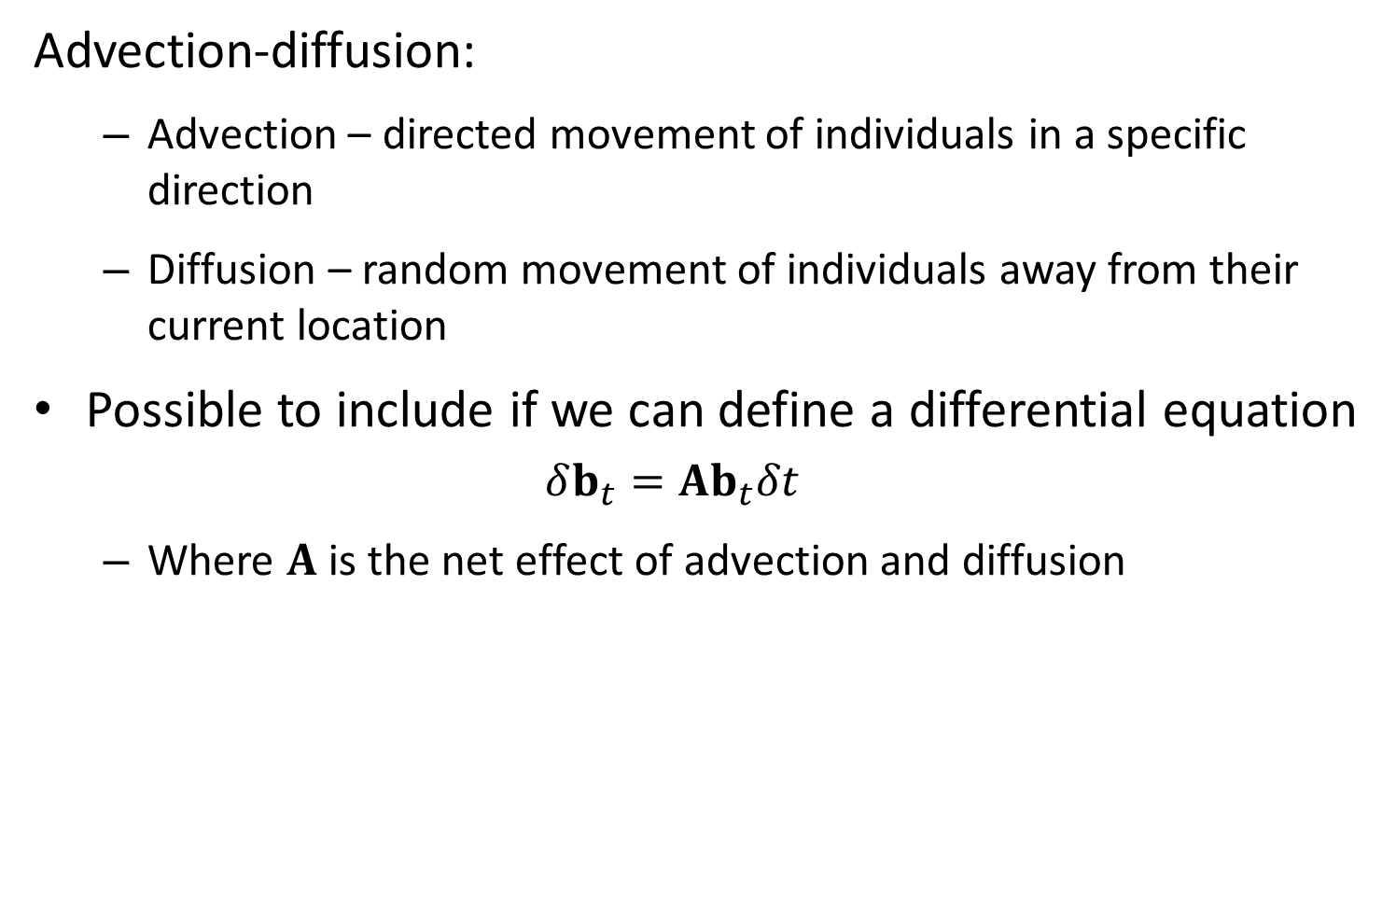
Movement
Advection-diffusion:
Advection – directed movement of individuals in a specific direction
Diffusion – random movement of individuals away from their current location
Possible to include if we can define a differential equation
$$δb_{t}=Ab_{t}δt$$
Where $A$ is the net effect of advection and diffusion

Slide 13
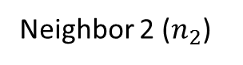
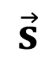
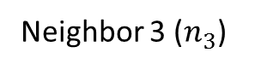

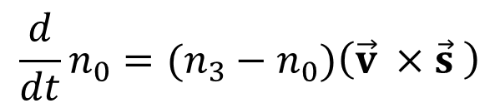
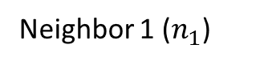
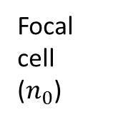
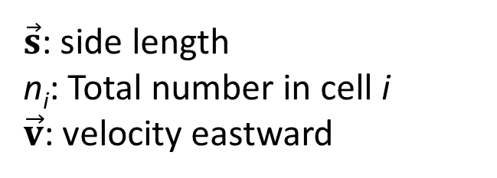
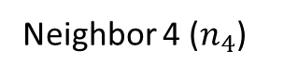
$\vec{s}$: side length
n_{i}: Total number in cell i
$\vec{v}$: velocity eastward
Neighbor 2 ($n_{2}$)
Neighbor 3 ($n_{3}$)
Focal cell ($n_{0}$)
Neighbor 1 ($n_{1}$)
$$\vec{v}$$
$$\vec{s}$$
Neighbor 4 ($n_{4}$)
$$\frac{d}{dt}n_{0}=(n_{3}−n_{0})\left(\vec{v} ×\vec{s} \right)$$

Slide 14
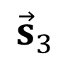
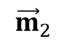
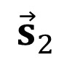
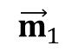
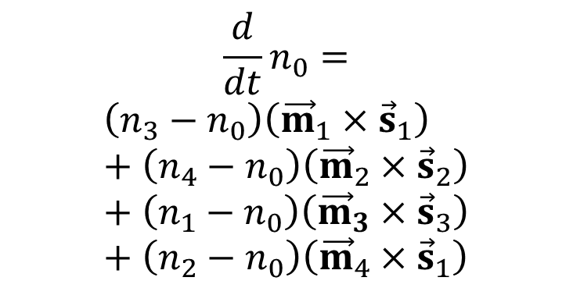
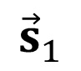
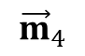
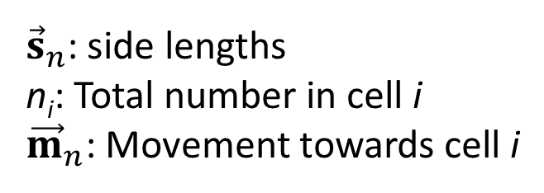
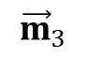
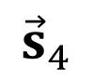
$${\vec{s}}_{2}$$
${\vec{s}}_{n}$: side lengths
n_{i}: Total number in cell i
${\vec{m}}_{n}$: Movement towards cell i
Neighbor 2 ($n_{2}$)
$${\vec{s}}_{3}$$
Neighbor 3 ($n_{3}$)
Focal cell ($n_{0}$)
$${\vec{m}}_{2}$$
Neighbor 1 ($n_{1}$)
$${\vec{m}}_{1}$$
$${\vec{s}}_{1}$$
$${\vec{m}}_{3}$$
$${\vec{m}}_{4}$$
Neighbor 4 ($n_{4}$)
$$\frac{d}{dt}n_{0}=$$
$$\left(n_{3}−n_{0}\right)\left({\vec{m}}_{1}×{\vec{s}}_{1}\right)+\left(n_{4}−n_{0}\right)\left({\vec{m}}_{2}×{\vec{s}}_{2}\right)+\left(n_{1}−n_{0}\right)\left({\vec{m}}_{3}×{\vec{s}}_{3}\right)+\left(n_{2}−n_{0}\right)\left({\vec{m}}_{4}×{\vec{s}}_{1}\right)$$
$${\vec{s}}_{4}$$

Slide 15
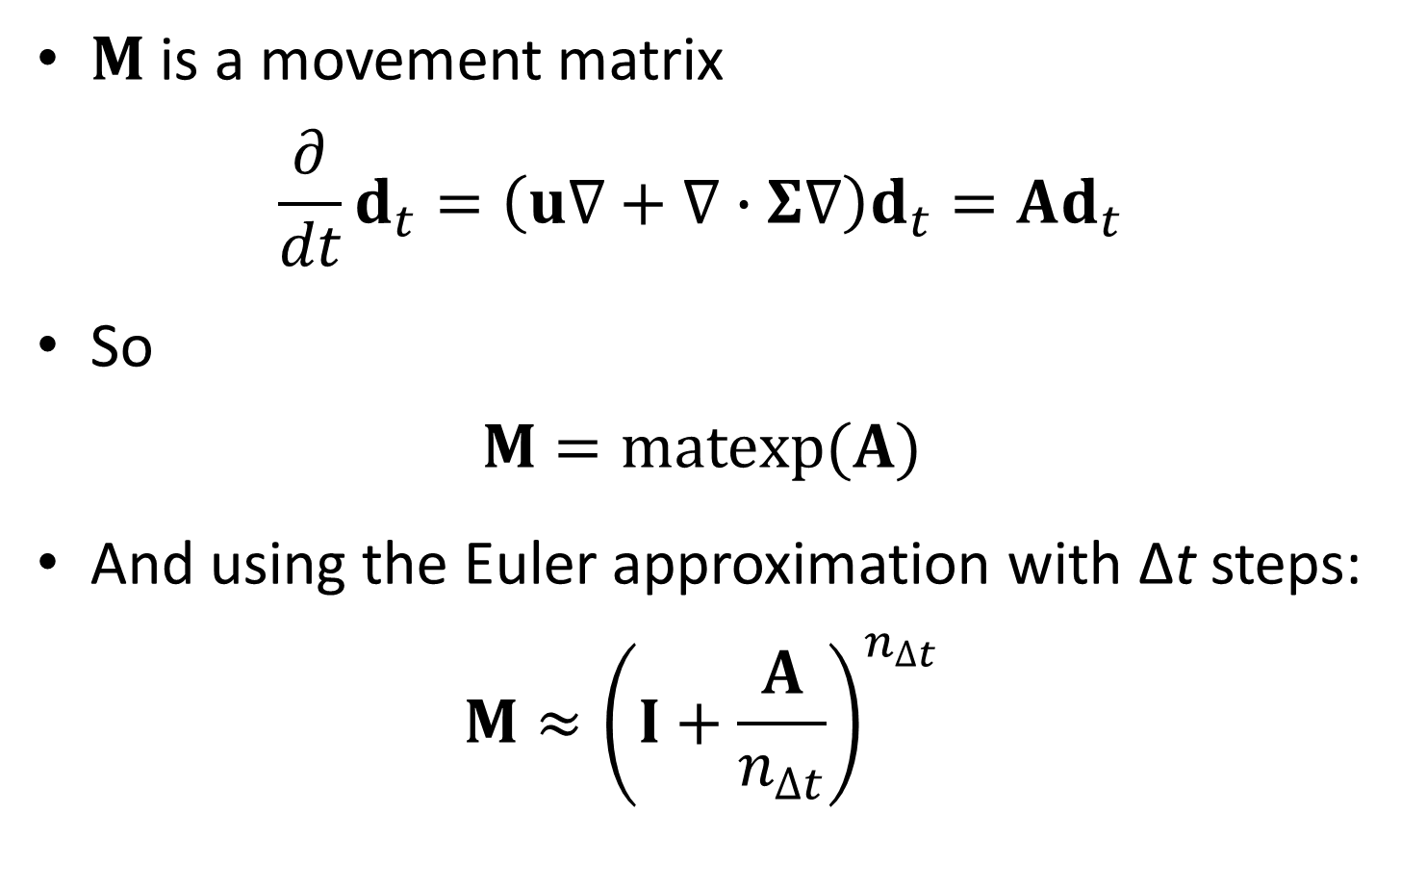
Movement
$M$ is a movement matrix
$$\frac{∂}{dt}d_{t}=\left(u∇+∇∙Σ∇\right)d_{t}=Ad_{t}$$
So
$$M=matexp(A)$$
And using the Euler approximation with Δt steps:
$$M≈{\left(I+\frac{A}{n_{∆t}}\right)}^{n_{∆t}}$$

Slide 16
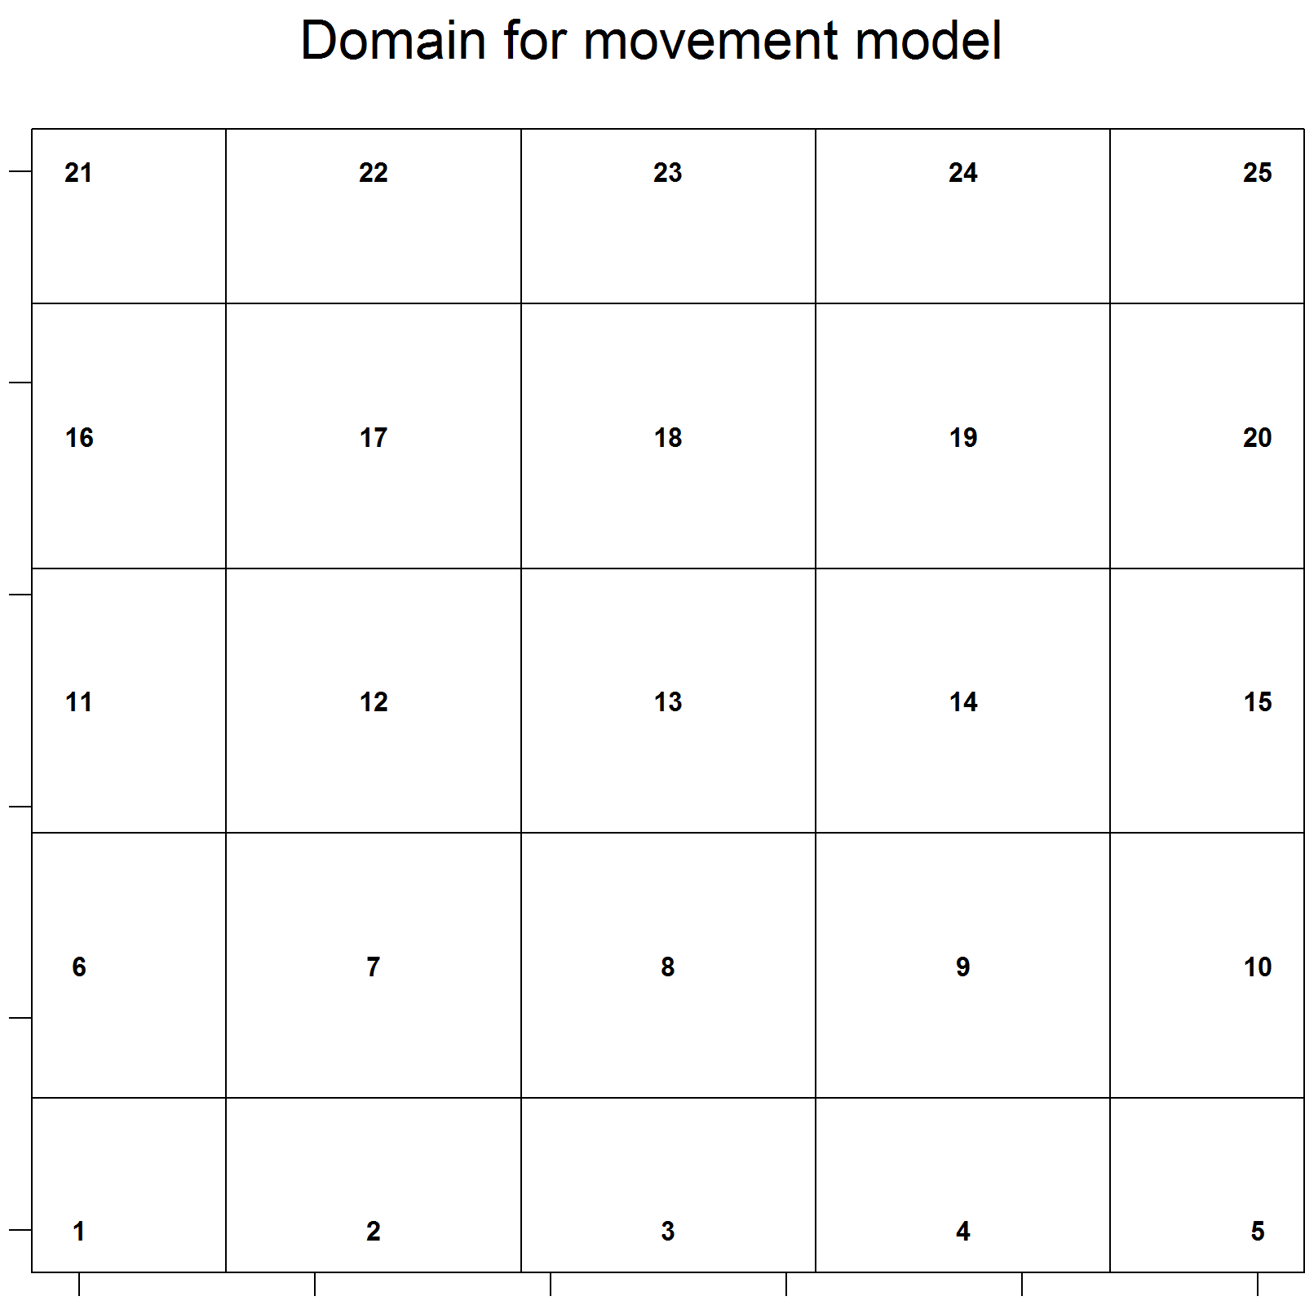
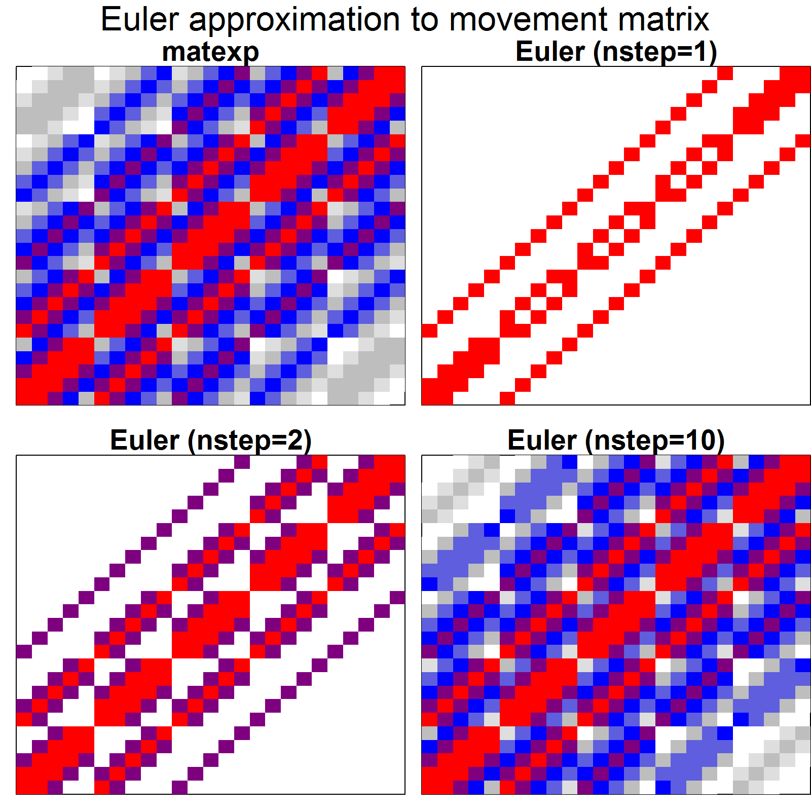
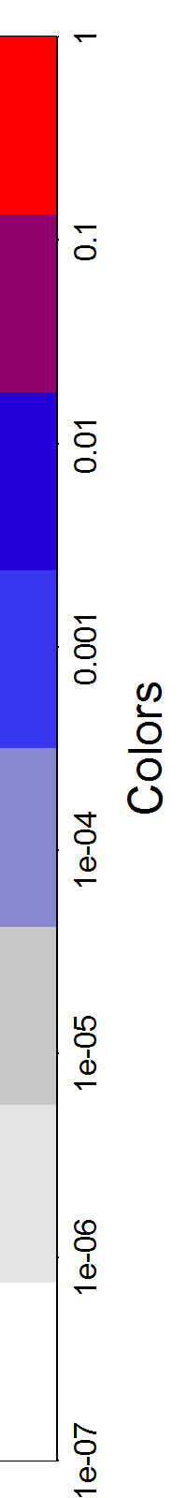
Movement
Euler approximation is sparse!
Sparseness / accuracy scales with number of steps

Slide 17
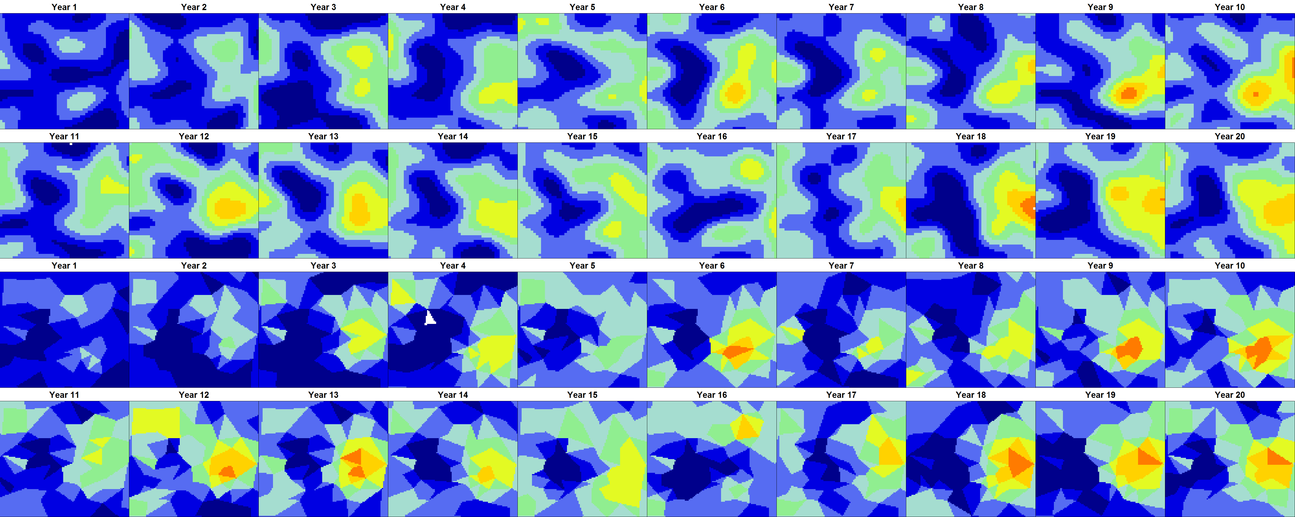
Movement
Highly separable computation
200 triangles + 20 years = 5 min. on laptop
Seems to recovery dynamics and density
Est / True
Est / True

Slide 18
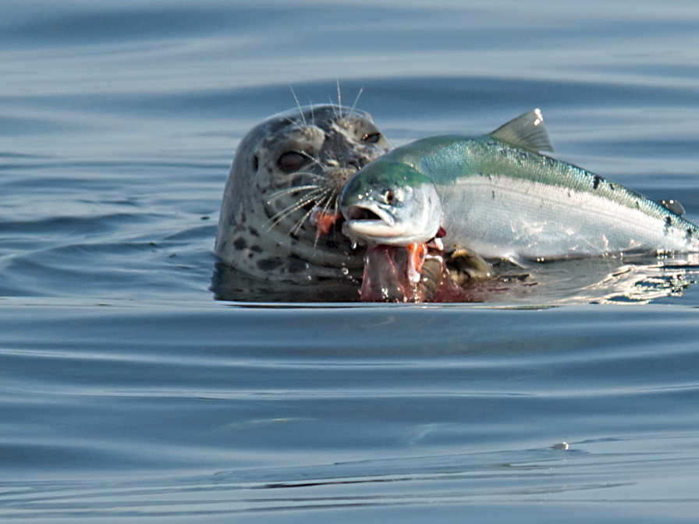
Community interactions and stability
Collaborators: Steve Munch and Doug Swain
Notes:
Harbor seal and sockeye

Slide 19
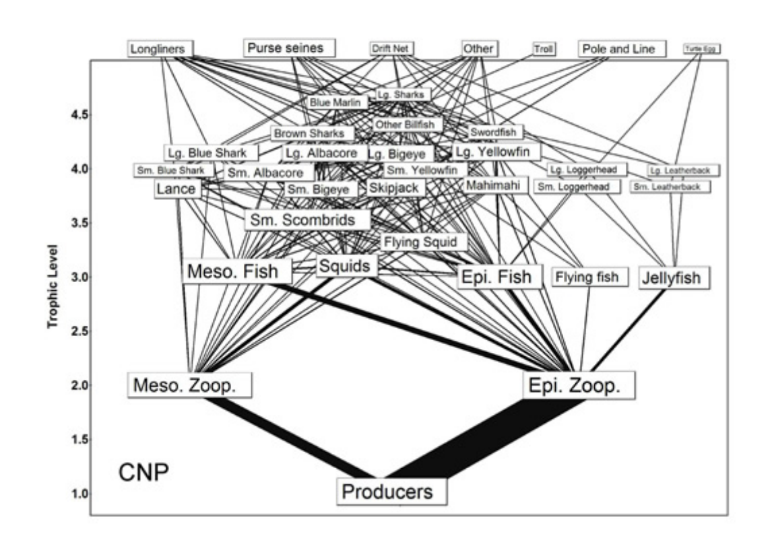
Horrendograms 101
Hinke, Kaplan, Aydin, Watters, Olson, and Kitchell. 2004. Visualizing the food-web effects of fishing for tunas in the Pacific Ocean. Ecol. Soc. 9(1): 10.

Slide 20
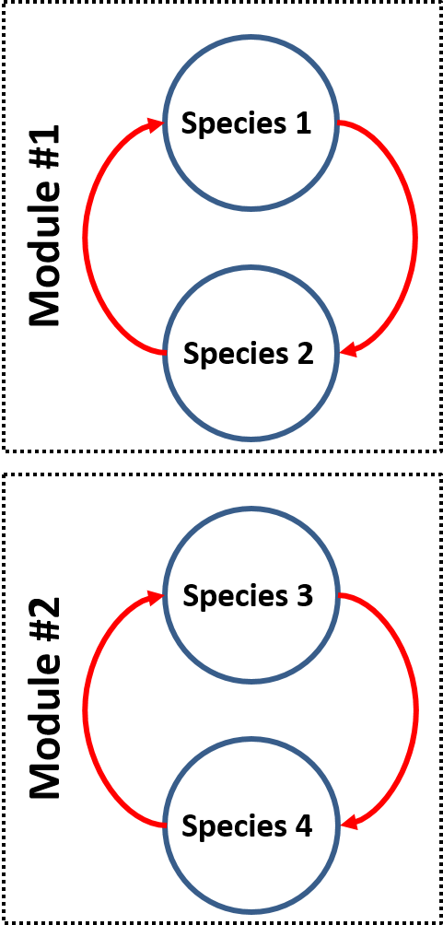
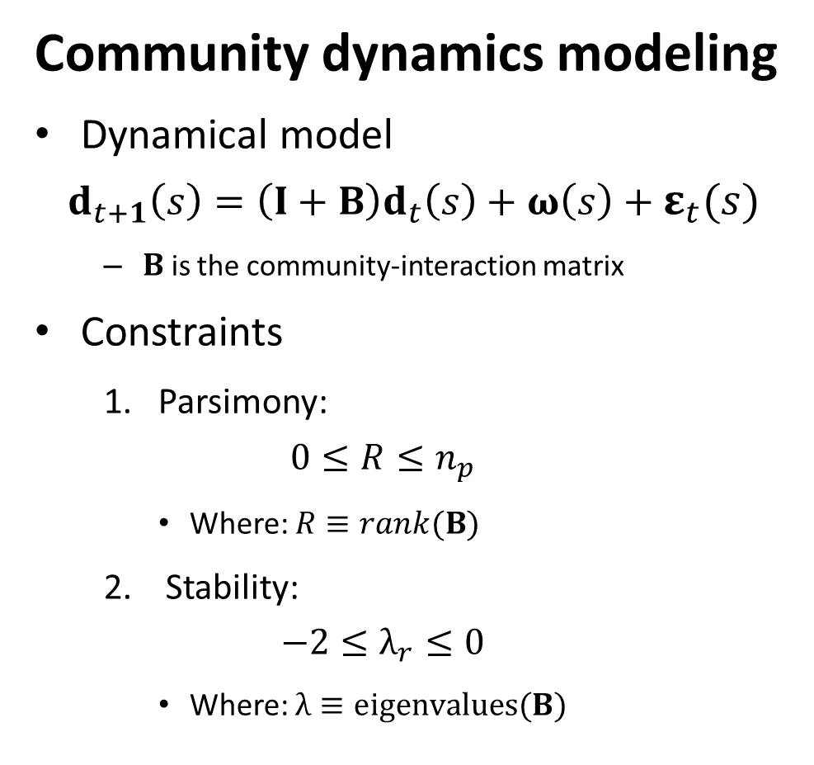
Community interactions
Community dynamics modeling
Dynamical model
$$d_{t+1}\left(s\right)=\left(I+B\right)d_{t}\left(s\right)+ω\left(s\right)+ε_{t}(s)$$
$B$ is the community-interaction matrix
Constraints
1. Parsimony:
$$0≤R≤n_{p}$$
Where: $R≡rank(B)$
Stability:
$$−2≤λ_{r}≤0$$
Where: $λ≡eigenvalues(B)$

Slide 21
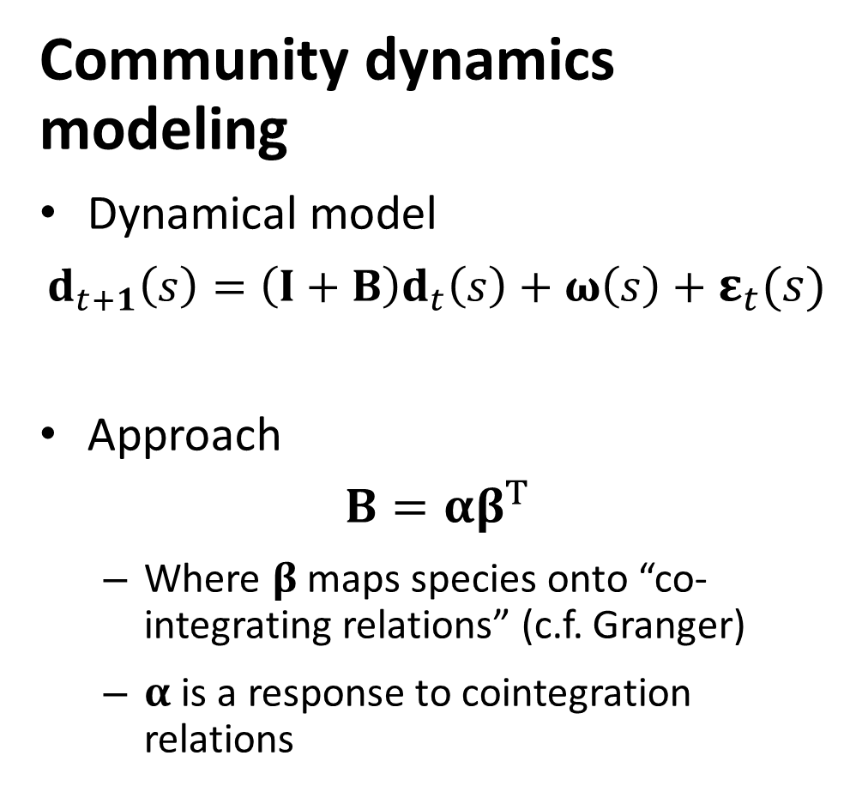
Community interactions
Community dynamics modeling
Dynamical model
$$d_{t+1}\left(s\right)=\left(I+B\right)d_{t}\left(s\right)+ω\left(s\right)+ε_{t}(s)$$
Approach
$$B=αβ^{T}$$
Where $β$ maps species onto “co-integrating relations” (c.f. Granger)
$α$ is a response to cointegration relations

Slide 22
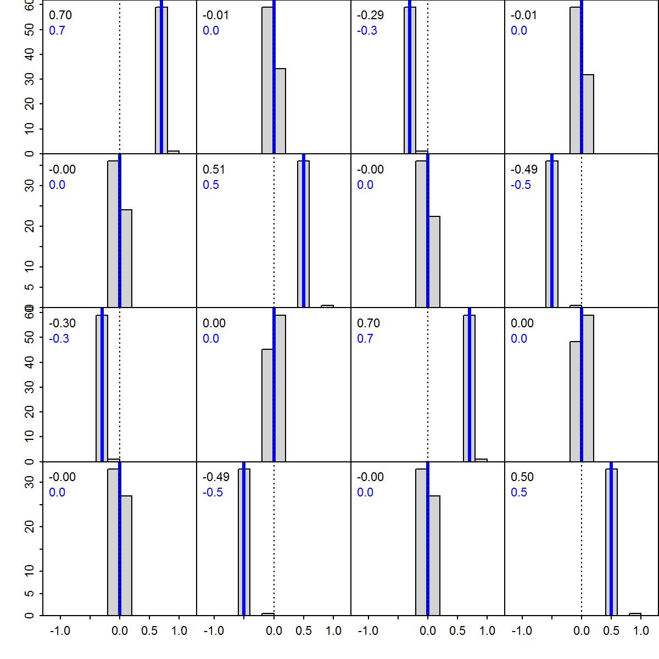
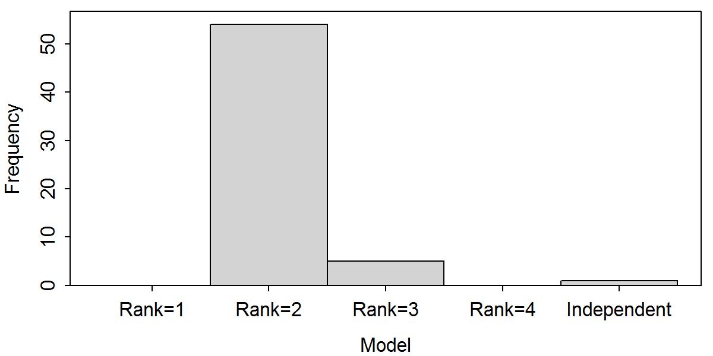

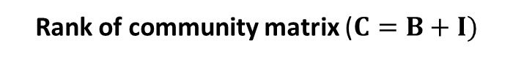
Community interactions
Simulation testing
Can estimate community matrix
Can identify rank
Community matrix ($C=B+I)$
Estimated / True
Rank of community matrix ($C=B+I)$

Slide 23
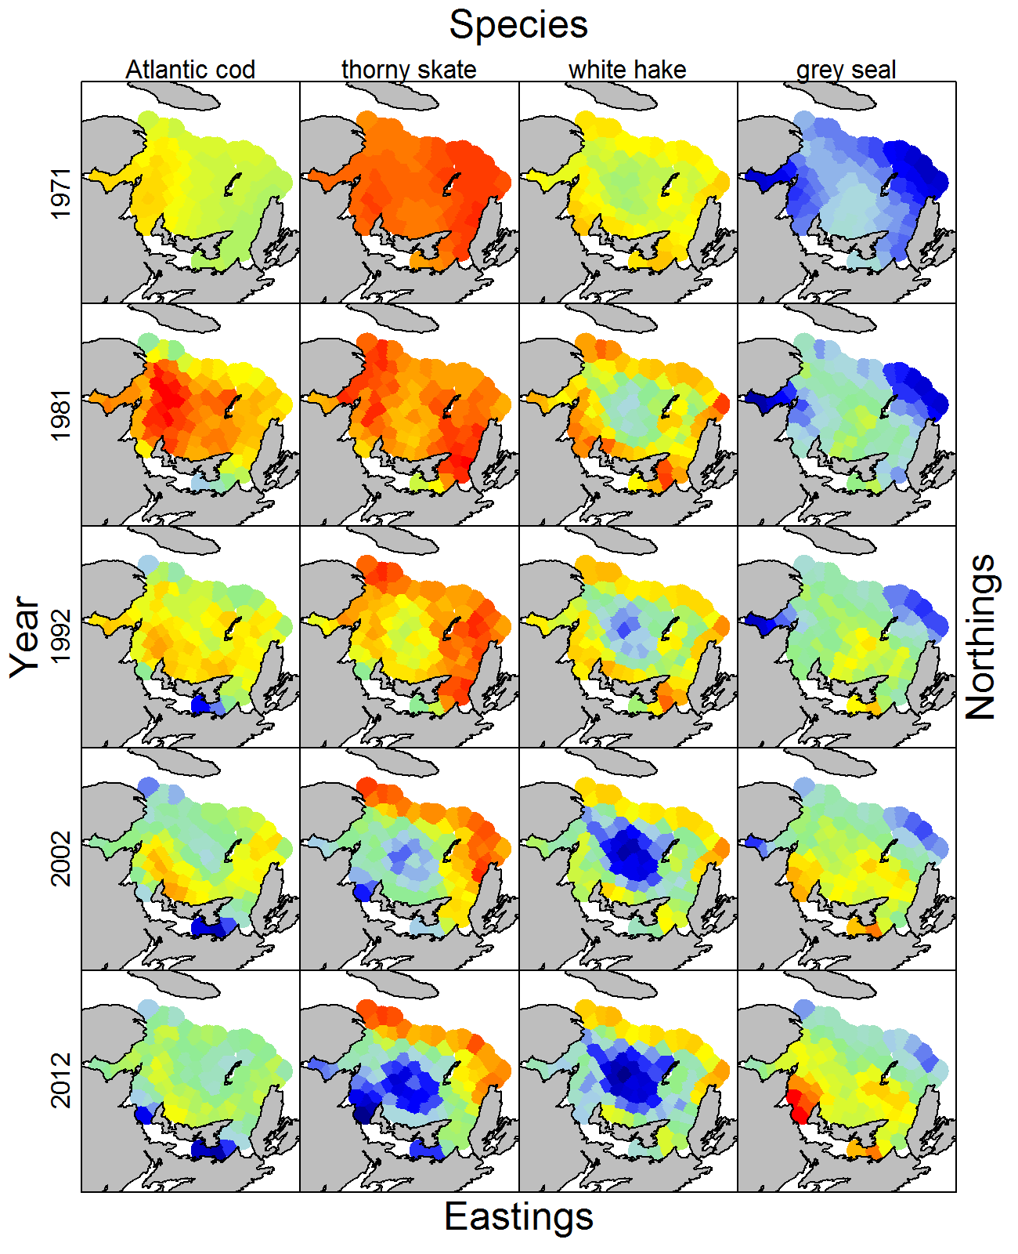
Community interactions
Case study
Gulf of St. Lawrence
Grey seals increasing
Fishes decreasing
White hake have biggest decrease
Atlantic cod decreasing near grey seal haul-outs

Slide 24
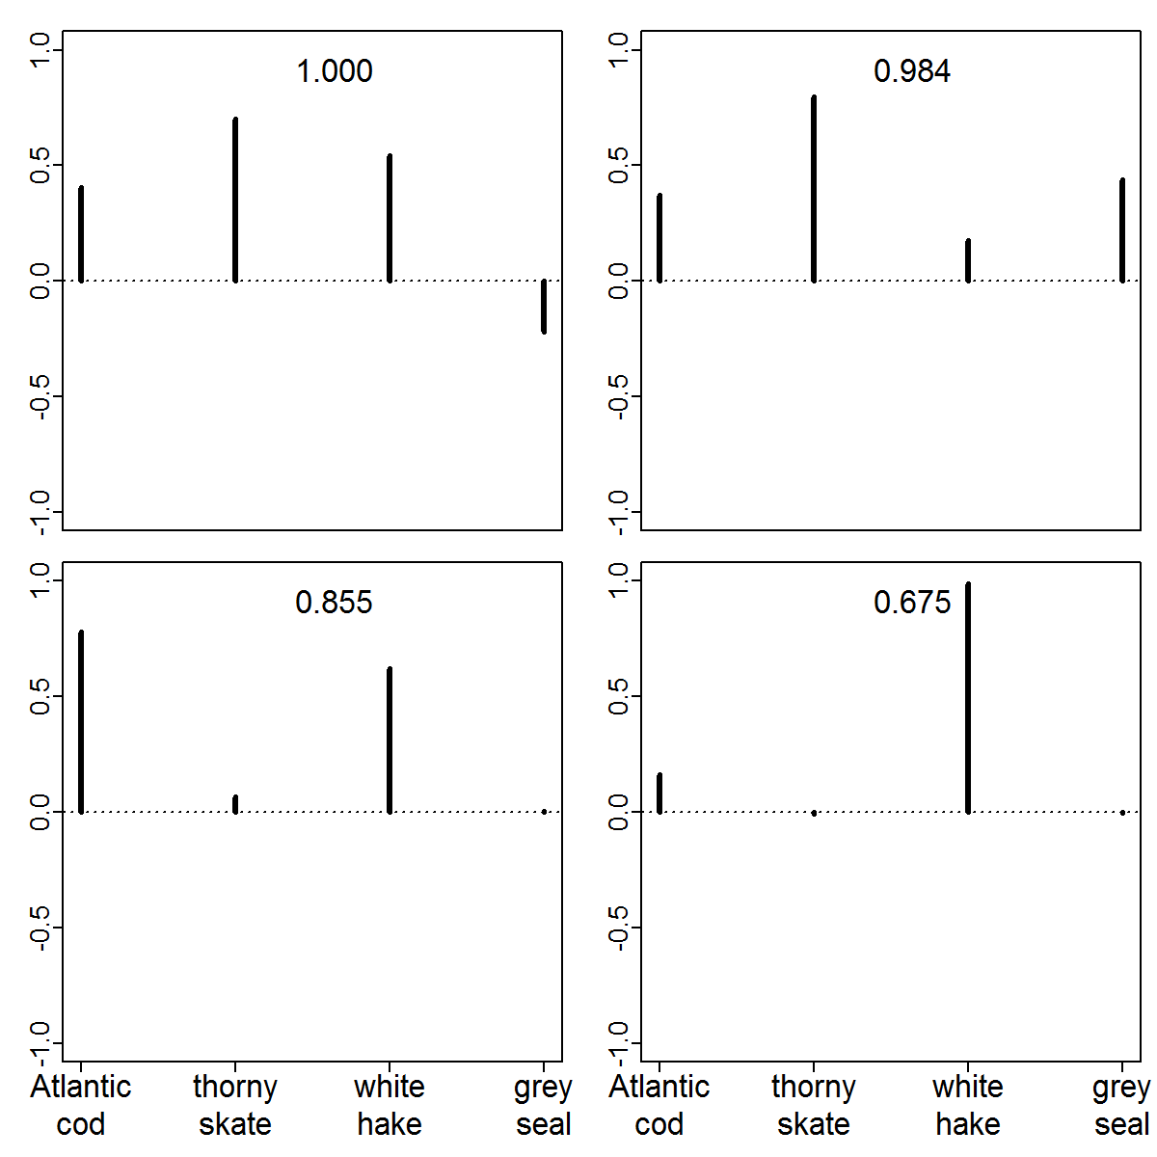

Community interactions
Conclusions
One density-independent axis
Represents unregulated dynamics
Increasing grey seals and decreasing fishes
Community matrix ($C=B+I)$

Slide 25
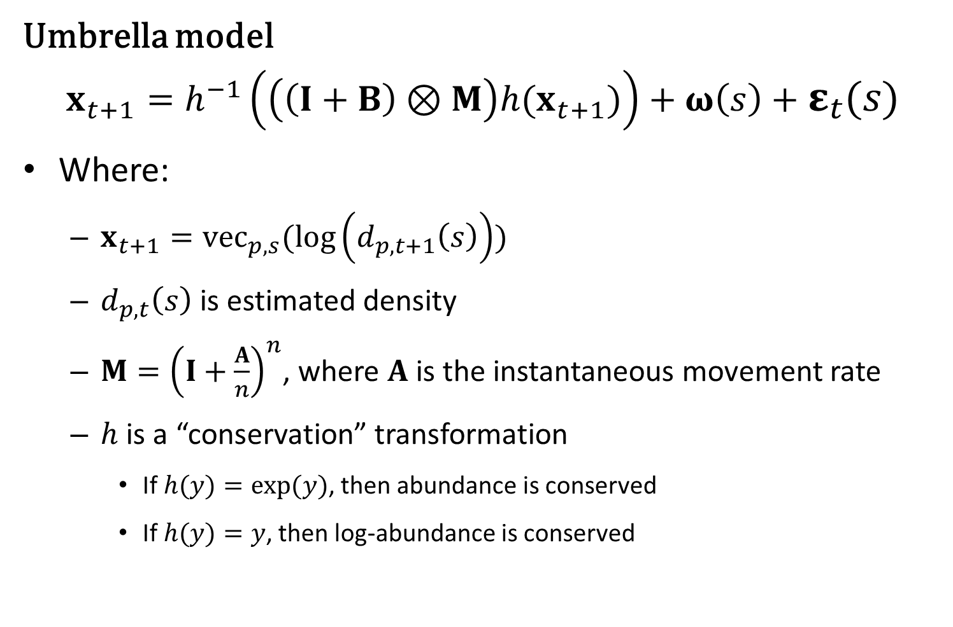
Uber-model
Umbrella model
$$x_{t+1}=h^{−1}\left(\left(\left(I+B\right)⊗M\right)h(x_{t+1})\right)+ω\left(s\right)+ε_{t}(s)$$
Where:
$x_{t+1}={vec}_{p,s}(log\left(d_{p,t+1}\left(s\right)\right))$
$d_{p,t}\left(s\right)$ is estimated density
$M={\left(I+\frac{A}{n}\right)}^{n}$, where $A$ is the instantaneous movement rate
$h$ is a “conservation” transformation
If $h(y)=exp⁡(y)$, then abundance is conserved
If $h(y)=y$, then log-abundance is conserved

Slide 26
Uber-model
Potential advancements
Variational Bayes
Uses Cholesky of random effects to generate “variational parameters”

